Slide 1


Automotive Vehicle Group
School of ECE
Stability Analysis of Particle Swarm Optimization Technique
Team No: 24
Students Details:
1. Spoorti R Angadi USN:01FE19BEC259
2. Ravikumar Radder USN:01FE19BEC262
3. Ifra USN:01FE19BEC266
4. Suraj Baddi USN:01FE19BEC268
Guide Details:
Prof. Rohit Kalyani

Slide 2
Automotive Vehicle Group
School of ECE
Contents
Introduction
Literature Survey
Need statement
Problem Statement
Theory
Functional Block Diagram
Gantt Chart
References

Slide 3

Automotive Electronics Group
School of ECE
Introduction
Optimisation:
What is Optimisation?
Importance of Optimisation:
Development of better designs.
Yield the best solution within the domain of study
Can trace and rectify problem in a remarkably easy manner..
Maximise profitability while observing environmental constraints.
Reduction of design time and engineering effort.
Solution
Solution
Solution
Best Solution
Solution
Solution

Slide 4
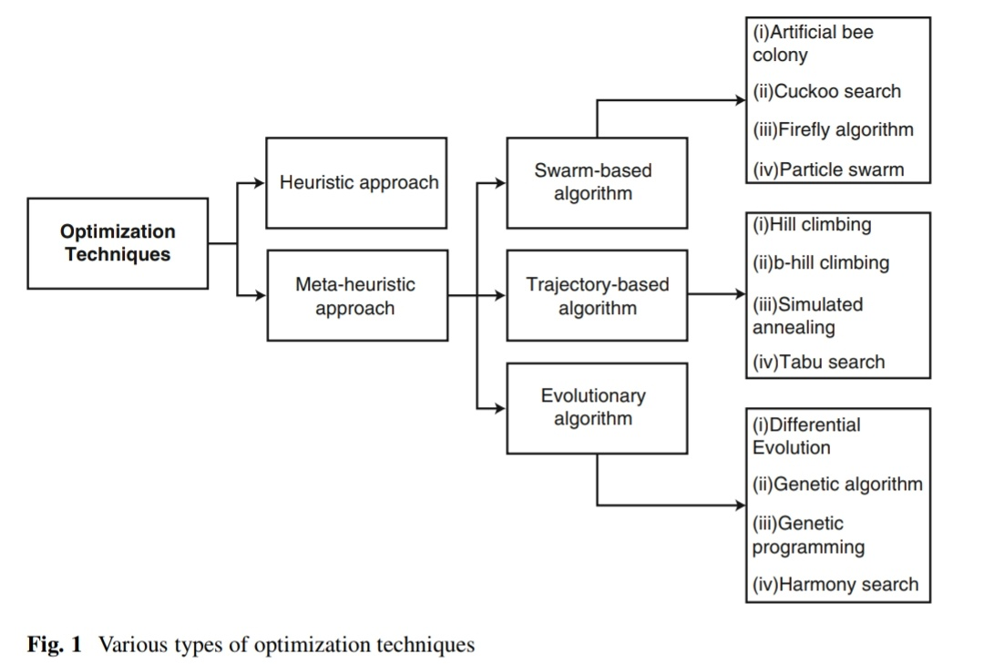
Automotive Vehicle Group
School of ECE
Introduction
Methods for Optimization:
Advantages of NIA:
Global Optimality
Simple and flexible
Can address hard problems
Can handle diverse range of problems
Easy to implement in parallel

Slide 5
Automotive Electronics Group
School of ECE
Nature Inspired Algorithms(NIA):
Fig1: Ant Colony Optimisation
Fig2: Swarm Intelligence
Advantages of NIA:
Global Optimality
Simple and flexible
Can address hard problems
Can handle diverse range of problems
Easy to implement in parallel

Slide 6
Automotive Vehicle Group
School of ECE
Literature Survey
Year | Publication | Paper Title | Author | Methodology | Outcomes of the Paper
1997 | DOI:10.1007/978-3-642-83051-8_5 | Numerical Optimization Techniques | Vandreplaats G.N. | Necessary Conditions for Optimality Unconstrained Minimasation Techniques Constrained Function Minimisation | Useful in finding the optimum solution or unconstrained maxima or minima of continuous and differentiable functions. Form a basis for developing advanced techniques more suitable to today’s practical problems.
2015 | DOI:0.1155/2015/931256. | A general framework of particle swarm optimization | Yudong Zhang, Shuihua Wang,and Genlin Ji | PSO Algorithm Discrete Optimization Binary Integer Programming Constrained Optimization | Brief Explanation Of PSO Comparison between Different Optimization Techniques Drawbacks Of PSO Evolution Of PSO

Slide 7
Automotive Vehicle Group
School of ECE
Literature Survey
Year | Publication | Paper Title | Author | Methodology | Outcomes of the Paper
2019 | DOI:10.1016/j.jocs.2020.101104 | Nature-Inspired Optimization Algorithms: Challenges and Open Problem | Xin-She Yang | Genetic, Ant colony, Particle swarm optimization algorithms Newton Raphson, Lyapunov, Von Neuman methods | Talks about challenges faced such as stability ,convergence, performance etc. in nature-inspired algorithms from theoretical perspective. Provides better understanding of the algorithms in terms of its convergence behavior, stability, advantages and as well as disadvantages.
2019 | DOI: 10.1007/s13369-019-03991-8 | On Stability Analysis of Particle Swarm Optimization Algorithm | 1.Anshul Gopal 2.Jagdish Bansal 3.Mohammad Mahdi Sultani | PSO Algorithm Von Nuemann Stability criteria Stability Analysis | Stability analysis was performed to limit the error generated during the iterative process of the PSO algorithm.

Slide 8
Automotive Vehicle Group
School of ECE
Literature Survey
Year | Publication | Paper Title | Author | Methodology | Outcomes of the Paper
2013 | - | Particle Swarm Optimization Stability Analysis | Djaneye-Boundjou, Ouboti Seydou Eyanna | Lyapunov based approach LaSalle-Yoshizawa theorem | Designing the Adaptive PSO Study of Stability and Convergence Purpose of Velocity Clamping Effect of Inertia Factor on the PSO algorithm
2019 | - | A Constriction Factor Based Particle Swarm Optimization for Economic Dispatch | Shi Yao Lim, Mohammad Montakhab, and Hassan Nouri | Constriction Factor based Particle Swarm Optimisation | Robust convergence characteristics. CFBPSO algorithm improves the convergence and performs better when compared with the improved PSO

Slide 9
Automotive Vehicle Group
School of ECE
Literature Survey
Year | Publication | Paper Title | Author | Methodology | Outcomes of the Paper
2011 | School of Engineering at Blekinge Institute of Technology | Mathematical Modelling and Applications of Particle Swarm Optimization | Satyobroto Talukder | Rate of Convergence Improvements Velocity clamping Inertia weight Constriction Coefficient Boundary Conditions Initialization, Stopping Criteria, Iteration Terms | Designing a better tuned PSO Algorithm with Parameters such as Swarm size, Iteration numbers, Velocity components, Acceleration coefficients. Advantages and Disadvantages of PSO, Applications of PSO.
- | Department of Mathematical and Computer Sciences, Huntingdon College | An Off-The-Shelf PSO | Anthony Carlisle, Gerry Dozier | Population size, neighborhood size , synchronous or asynchronous updates, and various additional controls, such as inertia and constriction factors. | The paper talks about set of values that constitutes a good PSO with according to social and cognitive learning rates and magnitudes.

Slide 10
Automotive Vehicle Group
School of ECE
Literature Survey
Year | Publication | Paper Title | Author | Methodology | Outcomes of the Paper
- | A Mathematical Introduction to Robotic Manipulation | Lyapunov Stability Theory | R. M. Murray, Z. Li and S. S. Sastry | Direct and Indirect Method of Lyapunov. | The paper Completely explains Lyapunov Stability with all it methods and Examples.
1997 | Journal of Global Optimization 11 Kluwer Academic Publishers | Differential Evolution – A Simple and Efficient Heuristic for Global Optimization over Continuous Spaces | Rainer Storn, Kenneth Price | Mutation, Crossover, Selection, Stochastic optimization, nonlinear optimization, global optimization, genetic algorithm, evolution strategy. | This paper presents a new heuristic(Differential Evolution Algorithm) for reducing possibly nonlinear and non-differentiable continuous space functions.

Slide 11
Automotive Vehicle Group
School of ECE
Literature Survey
Year | Publication | Paper Title | Author | Methodology | Outcomes of the Paper
- | University of Essex | Markov Chain Models of Bare-Bones Particle Swarm Optimizer | Riccardo Poli, William B. Langdon | Particle Swarm Optimization, Bare-bones PSO, Theory | We apply a novel theoretical approach to better understand the behavior of different types of bare-bones PSO's which allows the creation of discrete Markov chain models which approximate the behavior of a BB-PSO exploring a continuous space

Slide 12
Automotive Vehicle Group
School of ECE
Gaps Identified
Mathematical framework for stability and convergence
Parameter tuning
Role of benchmarking
Performance measures for fair comparison
Large-scale scalability

Slide 13
Automotive Vehicle Group
School of ECE
Need Statement
The stability analysis of optimization approaches is essential for the system's best performance. As a result, there is a need for tuning of optimisation parameters to ensure a bounded time response which contributes to improve the system's overall stability and responsiveness.
Problem Statement
To develop stability criteria and hence evaluate the rate of convergence of particle swarm optimization.

Slide 14
Automotive Vehicle Group
School of ECE
Objectives
Numerical Optimization Technique
Particle Swarm Optimization
Stability Analysis of Linear and Non-Linear systems
Propose a new methodology to determine stability of Optimization Technique
Evaluate Stability and rate of convergence of PSO.

Slide 15
Automotive Vehicle Group
School of ECE
Need for stability in PSO:
The solutions are provided by PSO in a probabilistic manner. Finding error bounds during the search process might therefore help in the creation of a better PSO. The knowledge regarding error bound comes from an algorithm's stability study.

Slide 16
Automotive Vehicle Group
School of ECE
Types of Stability:
BIBO Stability
Nyquist Stability
Routh-Hurwitz Stability
Jury Stability
Vakhitov–Kolokolov stability
Lyapunov Stability
Exponential Stability
von-Neumann Stability
Asymptotic Stability
Linear System
Non-Linear System

Slide 17
Automotive Vehicle Group
School of ECE
Lyapunov Stability:
Two methods for stability Analysis:
Indirect Method / Linearization Method
Direct Method / Based on Energy Concept
Non Linear System
Piecewise Linearization
Consider a small Region
Determine the characteristics of the linear function
Indirect Method:

Slide 18
Automotive Vehicle Group
School of ECE
Direct Method:
Dynamics of any physical system can be explained in terms of an energy function
The energy keeps on decreasing till it reaches to its equilibrium
At equilibrium position the time derivative of the energy function = 0

Slide 19
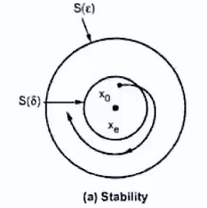
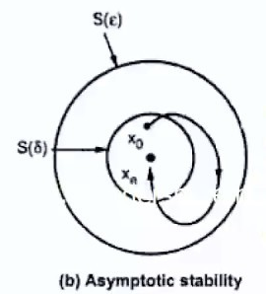
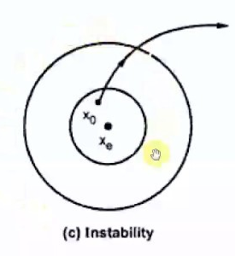
Automotive Vehicle Group
School of ECE
Stability in the sense of Lyapunov
An equilibrium state Xe of an autonomous dynamic system is stable in the sense of Lyapunov if for every ε>0 there exists and δ>0 where δ depends only on ε such that
||Xo-Xe|| <= δ
||Xt-Xe|| <= ε
Asymptotic Stability
An equilibrium point Xe of an autonomous dynamic system is asymptotic stable if it stable in the sense of Lyapunov and also there exists a δ such that every trajectory starting in the neighborhood of δ will converge to Xe
Instability
The Equilibrium state of an autonomous dynamic system is unstable for any real number ε>0 and any real number δ>0 irrespective of how small it is, there is always a state Xo such that the trajectories stating at this state leaves ε.
In short the system is unstable if state trajectories never come to equilibrium point
Stability in the sense of Lyapunov
An equilibrium state Xe of an autonomous dynamic system is stable in the sense of Lyapunov if for every ε>0 there exists and δ>0 where δ depends only on ε such that
||Xo-Xe|| <= δ
||Xt-Xe|| <= ε
Stability in the sense of Lyapunov
An equilibrium state Xe of an autonomous dynamic system is stable in the sense of Lyapunov if for every ε>0 there exists and δ>0 where δ depends only on ε such that
||Xo-Xe|| <= δ
||Xt-Xe|| <= ε
For all t >= t0
Xt

Slide 20
Automotive Vehicle Group
School of ECE
Particle Swarm Optimisation
Pi(t)
Xi(t+1)
Personal Best Position
Pi(t)-Xi(t)
Global Best Position
Vi(t+1)
Previous Position
Xi(t)
Updated Position
g(t)-Xi(t)
Vi(t)
g(t)
Vij(t+1) = wVij(t) + r1c1(Pij(t)-Xij(t))+r2c2(gj(t)-Xij(t))
Xij(t+1) = Xij(t) + Vij(t+1)

Slide 21
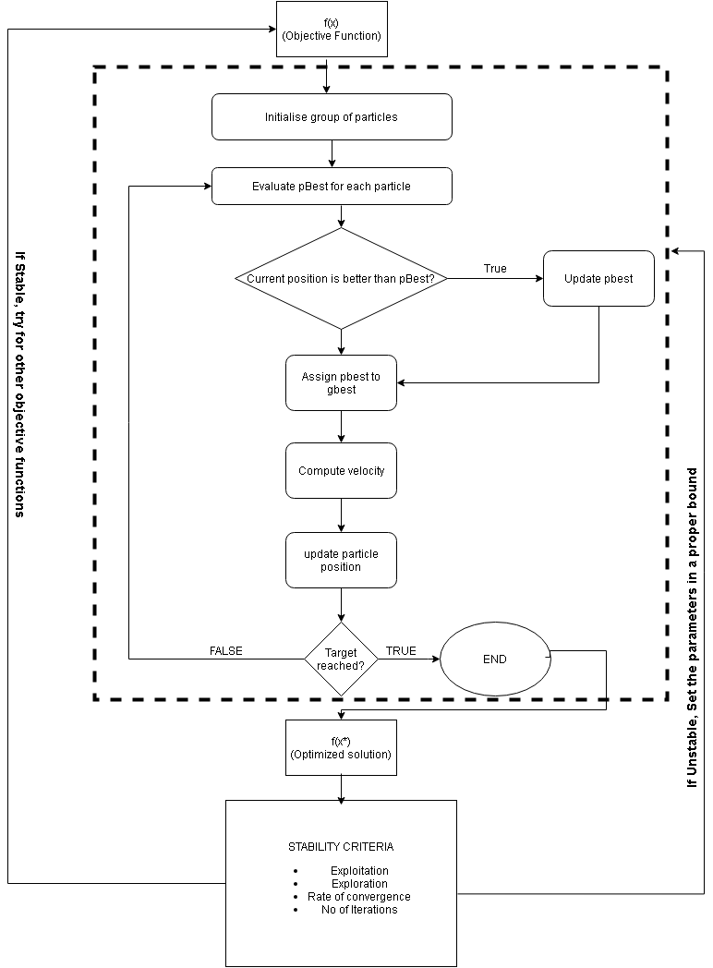
Automotive Vehicle Group
School of ECE
Flow Chart

Slide 22
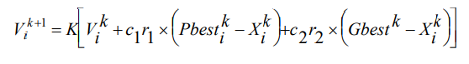
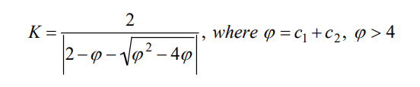
Automotive Vehicle Group
School of ECE
Code
Constriction Co-efficient
Clerc (Clerc 1999) in his study on stability and convergence of PSO have introduced a constriction factor K. The velocity of the constriction factor based approach can be expressed as follows:
The Convergence characteristic of the system can be controlled by φ.
Typically, when the constriction factor is used, φ is set to 4.1 (i.e. c1, c2 = 2.05) and the constant multiplier K is thus 0.729.

Slide 23
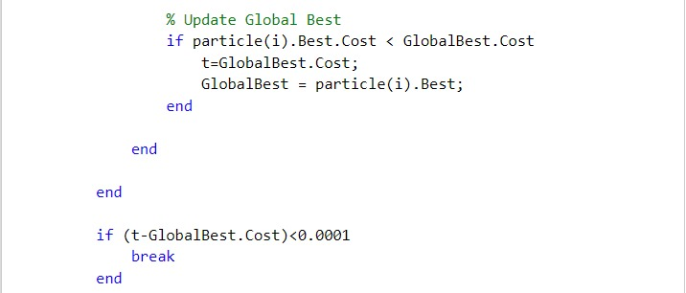
Automotive Vehicle Group
School of ECE
Code
Stopping Criteria
By defining the maximum number of iterations
Considering the average change of the particle’s position
Difference Method

Slide 24
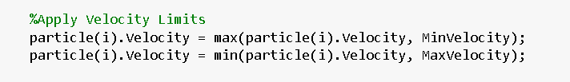
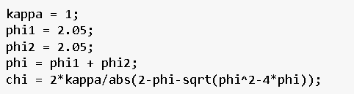
Automotive Vehicle Group
School of ECE
Code
Exploration and Exploitation:
Exploration is the ability to explore different area of the search space for locating a good optimum, while exploitation is the ability to concentrate the search around a searching area for refining a hopeful solution.
Can be solved using 2 methods:
Velocity Clamping
2. Constriction Co-efficient.

Slide 25
Automotive Vehicle Group
School of ECE
Parameter tuning:
Case | Condition | Result | Observations
Constriction Co-efficient | Using the concept of constriction co-efficient | Slow rate of convergence Higher Exploration More number of iterations | Since there is slow rate of convergence and it is taking more iterations to find the optimal value, the exploration is good
Damping Ratio | Decreasing the damping ratio | Fast rate of convergence Poor exploration | The standard value for damping ration should be 0.9
Population of particles | Increasing the population size | Faster rate of convergence Time taken to run the code increases | As the population increases, the search rate increases leading to faster convergence
phi1 and phi2 | Increasing the value | Chi decreases Faster rate of convergence Poor exploration | Since phi is inversely proportional to chi, the exploration decreases
phi1 and phi2 | Decreasing the value of phi1 and phi2 | Chi increases Good Exploration Slow rate of convergence | As the , constriction co-efficient increases which in tun increases the exploration which causes all particles to slowly spiral toward and around the best solution in the searching space without convergence guarantee.

Slide 26
Automotive Vehicle Group
School of ECE
Parameter tuning:
Case | Condition | Result | Observations
Velocity Clamping | Using Velocity clamping | Doesn’t go beyond the upper and lower decision variables | Velocity Clamping creates boundary to the search and makes sure that the particles stay within the boundary and find the minimum in the boundary area.
Personal and global Acceleration co-efficients | By changing the values of c1 and c2 | If the values of c1 and c2 is in the range of 1-2, then algorithm is stable | The standard value for c1 and c2 is in the range of 1-2

Slide 27
Automotive Vehicle Group
School of ECE
Copy Right and Plagiarism
Copy Right:
A copyright is a collection of rights that automatically vest to someone copies, and to perform and display the work who creates an original work of authorship like a literary work, song, movie or software. These rights include the right to reproduce the work, to prepare derivative works, to distribute publicly.
Plagiarism:
Plagiarism is presenting someone else's work or ideas as your own, with or without their consent, by incorporating it into your work without full acknowledgement. Plagiarism may be intentional or reckless, or unintentional.

Slide 28
Automotive Vehicle Group
School of ECE
References
Arabian Journal for Science and Engineering ISSN 2193-567X Volume 45 Number 4 Arab J Sci Eng (2020) 45:2385-2394 DOI 10.1007/s13369-019-03991-8
Vanderplaats G.N. (1987) Numerical Optimization Techniques. In: Mota Soares C.A. (eds) Computer Aided Optimal Design: Structural and Mechanical Systems. NATO ASI Series (Series F: Computer and Systems Sciences), vol 27. Springer, Berlin, Heidelberg. https://doi.org/10.1007/978-3-642-83051-8_5
Y. -l. Gao, X. -h. An and J. -m. Liu, "A Particle Swarm Optimization Algorithm with Logarithm Decreasing Inertia Weight and Chaos Mutation," 2008 International Conference on Computational Intelligence and Security, 2008, pp. 61-65, doi: 10.1109/CIS.2008.183.
Xin-She Yang, Nature-Inspired Optimization Algorithms: Challenges and Open Problems, Journal of Computational Science, Article 101104, (2020). https://doi.org/10.1016/j.jocs.2020.101104

Slide 29
Automotive Vehicle Group
School of ECE
Thank You

